Slide 1
Winston-Salem Fellows
Annual Report 2021-22 and Look Ahead to 2022-23

Slide 2
How Many FellowS Have Completed the Program?
2016 – 11 Fellows
2017 – 12 Fellows
2018 – 12 Fellows
2019 – 11 Fellows
2020 – 13 Fellows
2021 – 14 Fellows
(2022 – 8 Fellows)
Total = 81 Fellows!

Slide 3
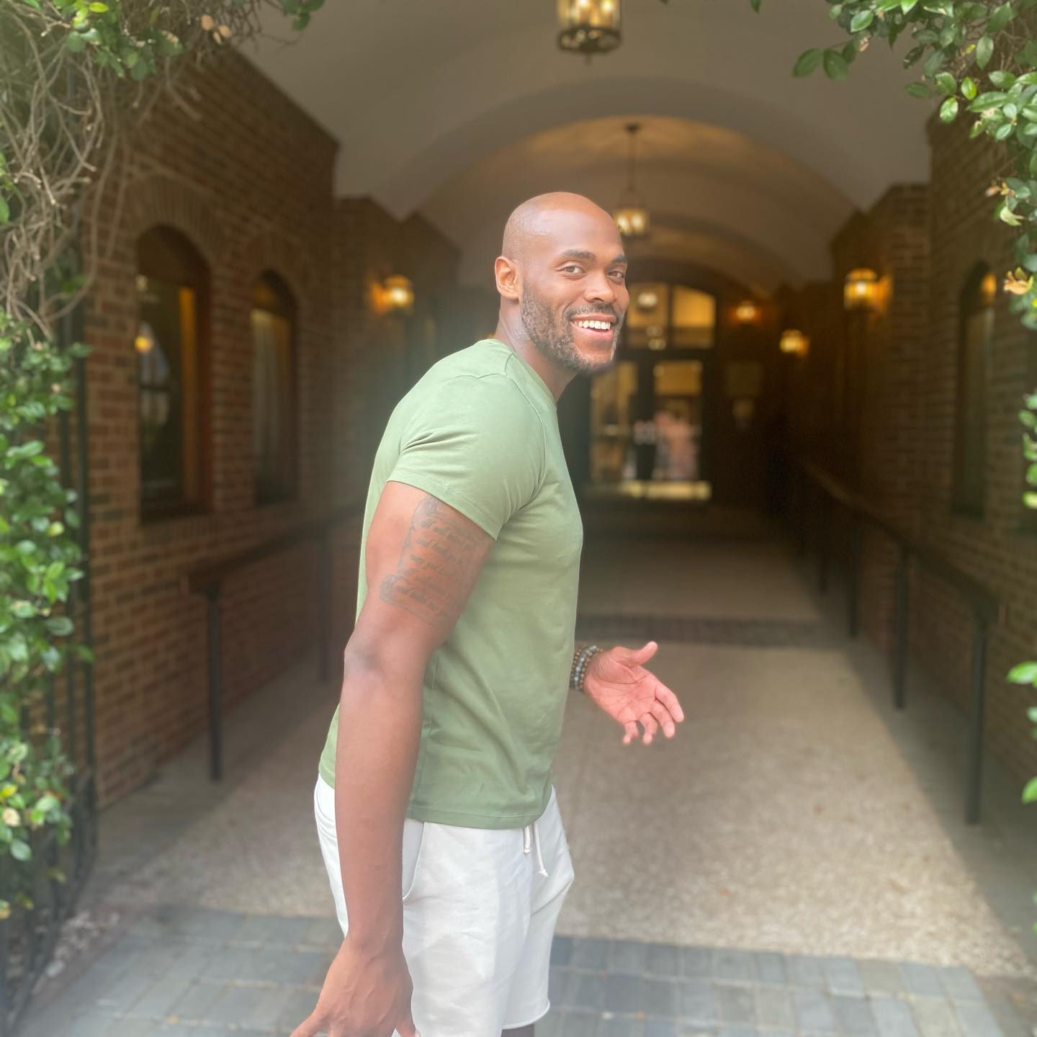
“The Fellows has given me a blueprint on how to live my life. A life surrounded in good community, a life of service, and life of faithfulness and gratitude.” – Mathu Gibson Class of 2019
The Winston-Salem Fellows was a great investment in my future. Instead of aimlessly walking into a career I am not passionate about, I decided to invest in myself. What I mean is that I took the time to understand myself better and learn how Mathu Gibson is wired.
During this program I have discovered my purpose in life, made lifelong relationships, connected with numerous leaders throughout the city of Winston Salem, gained valuable work experience, served in the most vulnerable communities, traveled abroad, strengthened my faith, and became a truer version of myself. What I am most proud of is the internal growth that has come out of intentional development. My confidence and self-esteem have grown, and I believe that came from getting out of my comfort zone and embracing every aspect of the program.

Slide 4
Other Stats
99% are seeking to integrate their lives around following Jesus.
96% are involved in a local church
79% remain in Winston-Salem at least one additional year post-program
51% are currently still living in Winston-Salem
97% would consider Winston-Salem as a place to live long term
$750,000 of revenue brought in from outside of the city.
Over 3,000 volunteer hours committed by community members to WS Fellows
Over 3,000 hours volunteered by WS Fellows

Slide 5
“God-given community moved mountains in my life that I believed were unshakeable” – Bryn Lenkaitis Class of 2021
“The Fellows program paints a picture of living life to the full, equipping men and women of faith to cultivate a kingdom ecosystem rooted in grace and truth. A flourishing ecosystem like the fellows program has multiple established vessels for the Lord to fill us up: Winston-Salem’s expansive network of community leaders pouring out His wisdom, homemade host family dinners feeding you mind, body and soul, walks with mentors that shine light on what God is doing, round tables spent worshipping around a bonfire, the inquisitive young minds at church small group and the many advances to the lake or cabin spent in prayer.”

Slide 6
Special Thanks to 2021-22 Churches, Employers, Families and mentors
Churches:
1st Pres
Hope Presbyterian Church
Redeemer Presbyterian Church
Reynolda Church
River Oaks Community Church
Southside Community Church
Employers:
Catherdral Oaks Academy
Penny Path Café
Fast Med
Wake Forest Faith Health
Wake Forest Inst. for Regenerative Medicine
Forsyth County Government
Boosterthon
Novant Health
Flow
Crosby Scholars
Love Out Loud
Budd Group
Families:
The Russ family
The Otto Family
The Burns family
The Rudnicke family
The Askew family
The Sumanth Family
The Nicholson family
The Snow family
The Amrich family
The Summers family
The Gardner family
The Johnson family
The Trollinger family
Mentors:
Deb Pozenbanchuk
Ellen Hilliard
Phillip and Melissa Summers
Steve and Chrisy Angle
Carrie Friesen
Ann Darrah
John sanders
Tina Parker
Cindy Steele
Tim Gupton
Frank McNair
Chris McLaughlin
Christal Giese
Peter Mikael

Slide 7
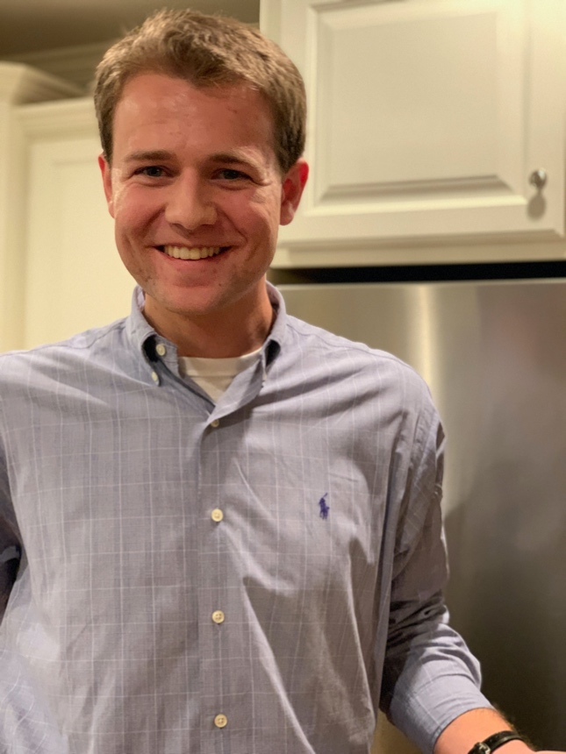
“Fellows gave me valuable work experience, great friends, and deep relationships in the community that continue three years later.” – Jackson Wood Class 2020
I am immensely grateful for the opportunity that I had to do the Winston-Salem Fellows program. The Fellows gave me valuable work experience, great friends, and deep relationships in the community that continue three years later. Additionally, the classes and assessments I took enabled me to grow in amazing ways because they taught me a lot about both God and myself. I truly believe that the Fellows provided me with an excellent foundation upon which to live a life that glorifies God and impacts others in meaningful ways.

Slide 8
Our 2022-23 Line-up
Churches:
1st Presbyterian
Hope Church
Redeemer Presbyterian
Reynolda Church
Employers:
Forsyth Country Day School
United Way
Chandler Physical Therapy
Crosby Scholars
Senior Services
Fast Med
New Canaan Society
Cassia Capital
Lewisville Chamber of Commerce
Family:
The Sloan family
The Zimmerman family
The Hilliard family
The McDaniel family
The Crisco family
The Sumanth family
The Zayas family
The Paynter family
Mentors:
Ann Powers
Al Murfee
Kathy Hatch
Tammy Priest
Andrew Applegate
Lynn Anthony
Shelley Bailey
Noah Downs

Slide 9
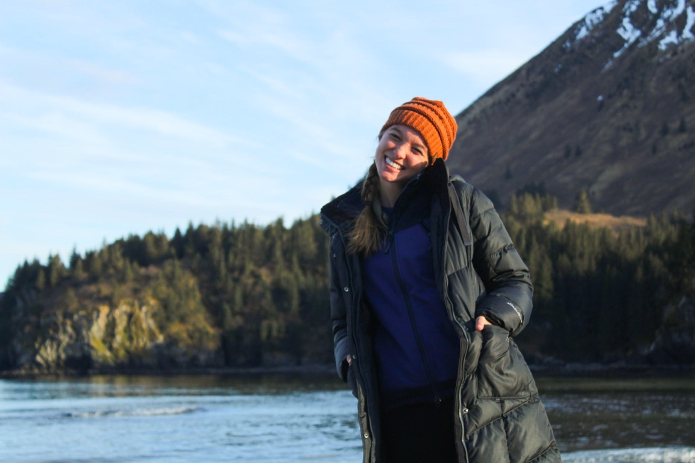
“Choosing to do the WS Fellows Program was one of the best decisions I have ever made.” – Molly Dwyer Class of 2022
The WS Fellows network offered incredible opportunities for spiritual and professional mentorship, and the program itself was structured in a way that fostered deep and lasting connections with the city of Winston-Salem.
This was a year of fellowship, mentorship, growth, and discovery; I learned more about who I am and who God created me to be, and how I have been gifted to serve in the world. In the WS Fellows, I spent a year investing in the rest of my life, and I know I will continue to reap the benefits of this year of intentionality. I truly believe that anyone who has the opportunity should choose to do a fellows program, and in my opinion, WS is the best choice.

Slide 10
Finance Update

Slide 11
Budget 2022-23 $180,000

Slide 12
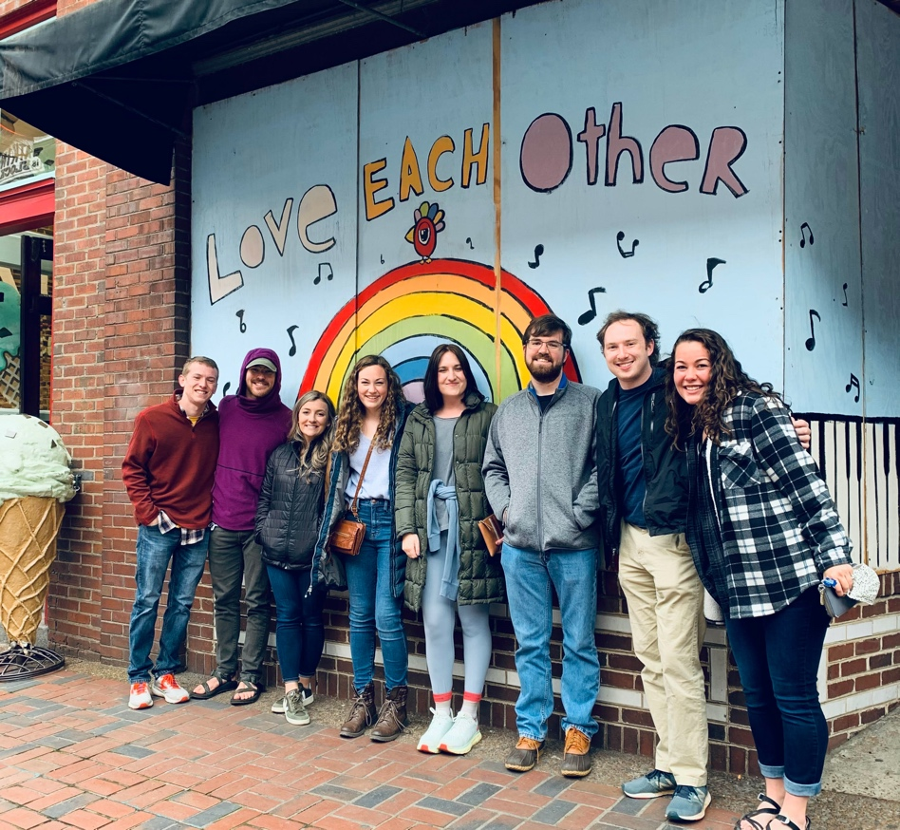
“The Winston-Salem Fellows program offers a glimpse of what the Church should be: a community dedicated to falling in love with the Lord, and by extension, everything in His kingdom.” – Sam Bishop Class of 2021
Whether it's the city of Winston-Salem, the joyful noises of passionate worship, the intricacies and complexities of how those around you interpret Scripture, or the incredible people that make up the community around you, you not only notice that God is at work but experience it so deeply that you can't help but thank Him. And sure, things aren't perfect- the world as it is never will be- but when hardships arise, you're met by a whole community that will get you as close as earthly-possible to understanding the word Agape.

Slide 13
Join us!
The Winston-Salem Fellows runs on community!
We invite you to join us!
Volunteer – Email Us to learn more
Pray – join our monthly prayer zoom. Email us to enroll
Financial Support – Give Now
consider giving monthly (follow the options on our website)

Slide 14
THANK YOU!
To learn more, go to wsfellows.com
Our mailing address is:
Winston-Salem Fellows
PO Box 20514
Winston-Salem, NC 27120
The Winston-Salem Fellows Program is a 501c3 non-profit organization.
Send your donation or submit one online at
http://wsfellows.com/give
Thanks!

